Slide 1
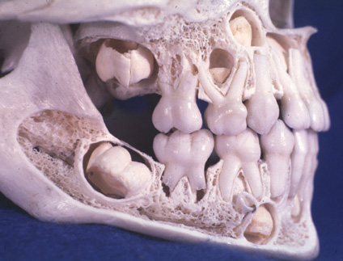
RUNGTA COLLEGE OF DENTAL SCIENCES & RESEARCH
OCCLUSION
DEPARTMENT OF ORAL PATHOLOGY

Slide 2
Specific learning Objectives
Core areas* | Domain ** | Category #
Definition of occlusion | COGNITIVE | MUST KNOW
Introduction to occlusion Classification of occlusion Stages / Periods of Occlusion Development | COGNITIVE COGNITIVE COGNITIVE | MUST KNOW MUST KNOW MUST KNOW
Occlusion terminologies & Curves Balanced occlusion Keys to normal occlusion Centric occlusion | COGNITIVE COGNITIVE COGNITIVE COGNITIVE | MUST KNOW MUST KNOW MUST KNOW NICE TO KNOW

Slide 3
OBJECTIVES
To know the various stages of occlusion development and their application in clinical aspects relating to eruption, shedding and development of malocclusions

Slide 4
CONTENTS
Definition of occlusion
Introduction to occlusion
Classification of occlusion
Stages / Periods of Occlusion Development
Occlusion terminologies & Curves
Balanced occlusion
Keys to normal occlusion

Slide 5
DEFINITION - Occlusion
Angle :
The normal relation of the occlusal inclined planes of teeth when the jaws are closed
Occlusion literally means “ CLOSING”.

Slide 6
It is the relation between maxillary & mandibular teeth when they are in contact ( static ) and during various jaw movements.
Simplistic meaning :-
The way teeth meet and function.

Slide 7
ANGLE CLASSIFICATION OF MAL OCCLUSION
Div I
Class I Class II Class III
(Normal) Div II

Slide 8
Buccal Aspect of 1st Molar
ML
DL
MB
DB
D
PREMOLAR
2nd MOLAR

Slide 9
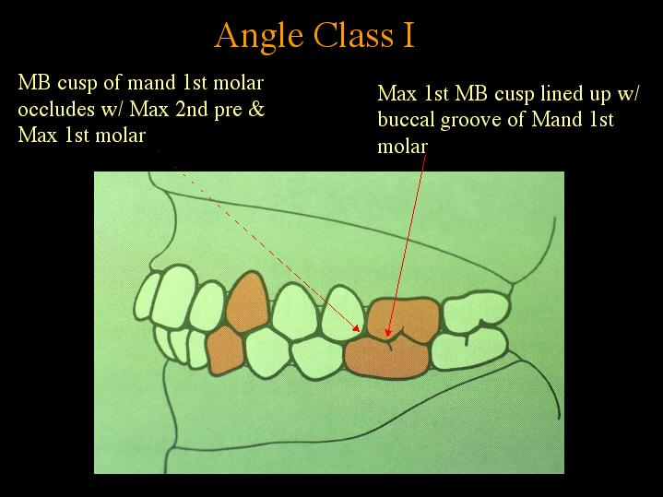
2nd
premolar
1st
molar
canine
1st
premolar
MB
DB

Slide 10
Overbite = Vertical Overlap (Black arrow)
Overjet = Horizontal overlap (White arrow)

Slide 11
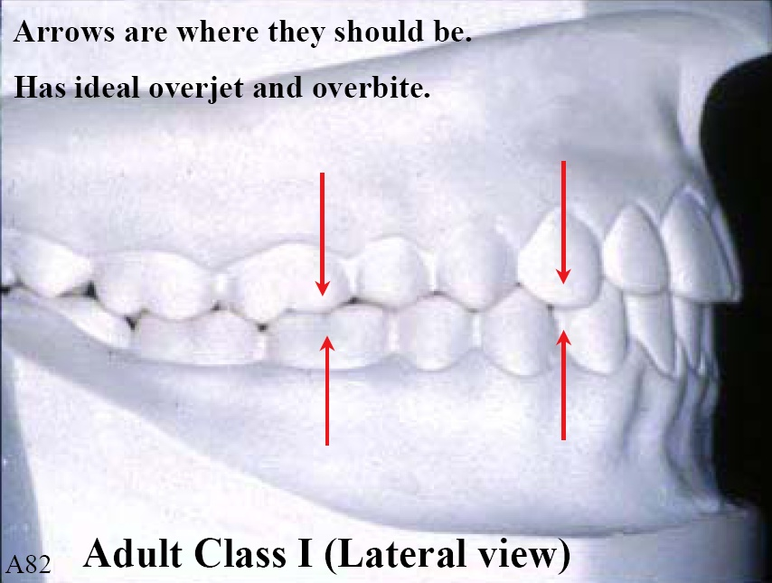
Class I occlusion – Ideal Overjet & Overbite
Ideal occlusion.

Slide 12
1st
molar
MB
DB

Slide 14
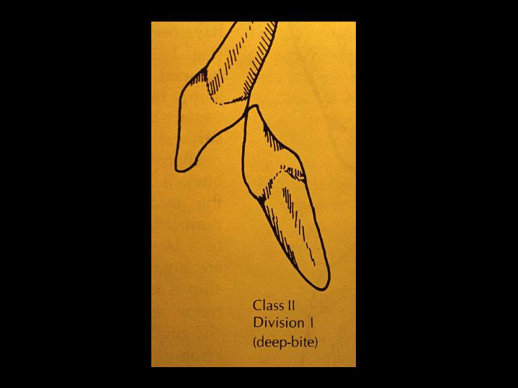

Slide 16
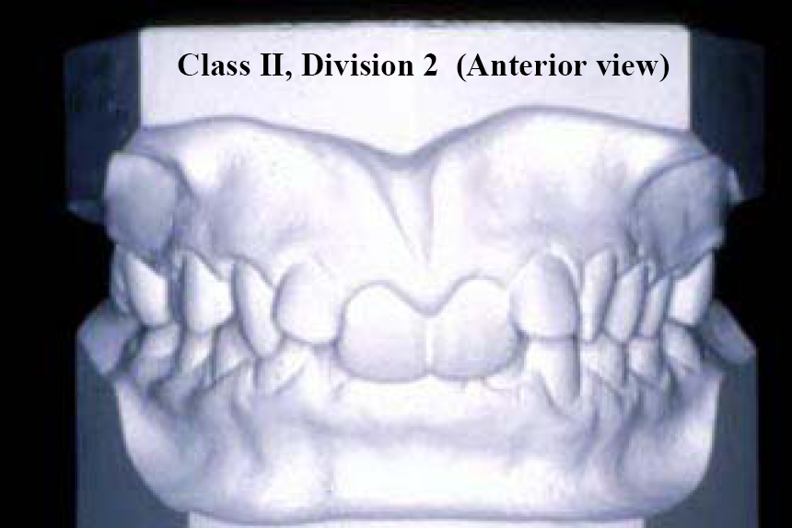

Slide 17
2nd
premolar
1st
molar
MB
DB

Slide 18
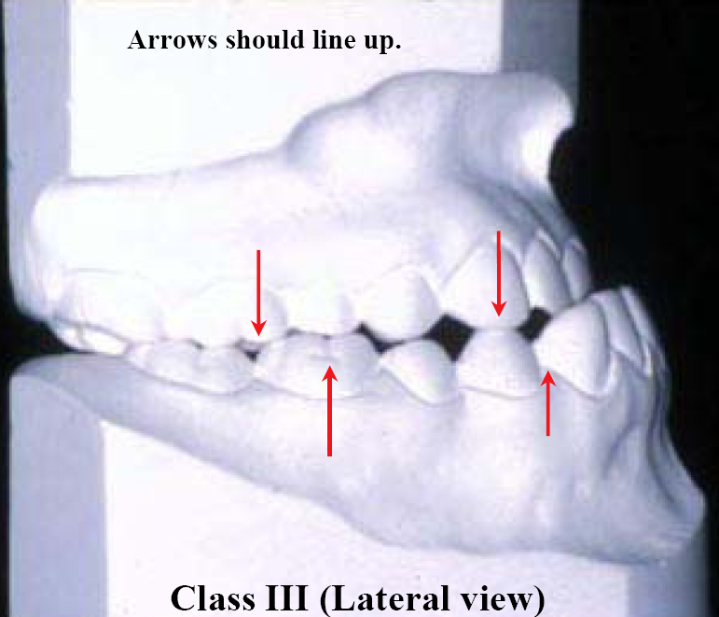
Class III Malocclusion
The ‘bulldog look’

Slide 20
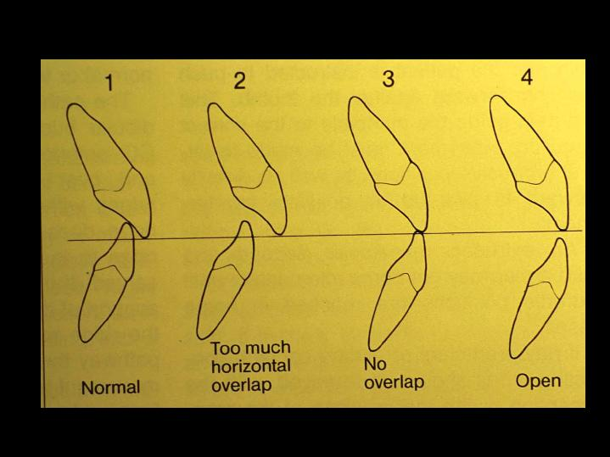

Slide 21
Maxilla normally placed
Maxilla forwardly placed
Mandible forwardly placed

Slide 22
Stages / Periods of Occlusion Development
Pre dental period /stage (At time of birth – 6 months)
Deciduous dentition period/ stage ( 6 months till 6 years )
Mixed dentition period / stage ( 6 years till 12-13 years )
Permanent dentition period / stage (14 year onwards)

Slide 23
Pre Dental period
At birth till 6 months after birth
Absence of teeth
Gum Pads (alveolar process at time of birth – pink, firm & fibrous)
Horse shoe shaped
Develop in 2 parts : Buccal/Labial &
Lingual/Palatal

Slide 24
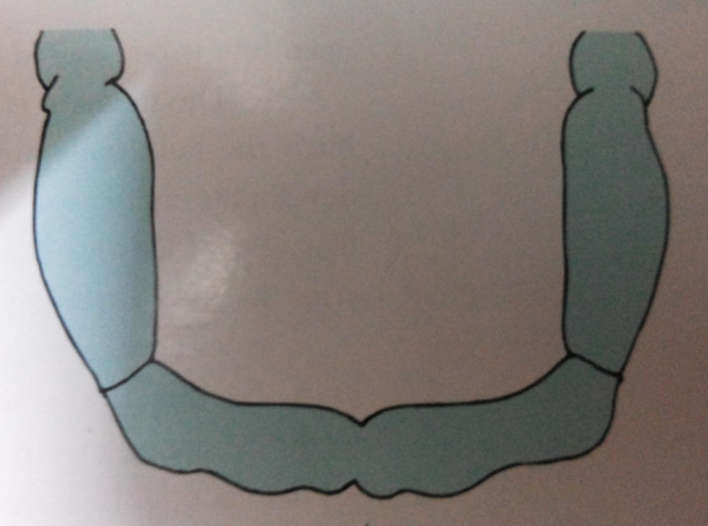
Maxillary Gum Pad
Mandibular Gum Pad

Slide 25
3 grooves are present
Dental groove separates 2 parts (buccal & lingual)
Transverse grooves divides Gum Pad into 10 segments (Each segment = 1 developing tooth sac )
Gingival groove – separates gum pad from palate & floor of mouth

Slide 26
Transverse groove
Gingival groove
Dental groove

Slide 27
Lateral sulcus – transverse groove between canine & 1st molar
Helps in judging inter-arch relationship

Slide 28
Lateral sulcus

Slide 29
INFANTILE OPEN BITE
Upper gum pad – more larger, wider & longer than mandibular
Contact between two gum pads occur at – 1st Molar region = space between anterior region called as INFANTILE OPEN BITE

Slide 30
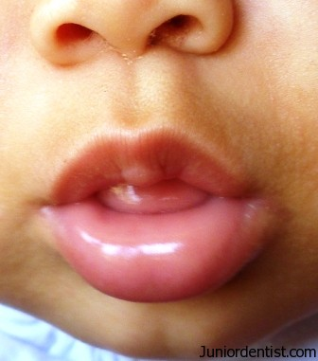
1st molar region
1st molar region
INFANTILE OPEN BITE
Considered as Normal
Helps in suckling

Slide 31
Deciduous dentition period
6 months till 3 years (when 2nd molars come in occlusion)
Eruption age & sequence of eruption
Mandibular incisors – 1st teeth to erupt – 6 to 7 months

Slide 32
Natal & Neonatal teeth
Also called Foetal / Congenital teeth
Natal teeth are teeth that are present at birth.
Neonatal teeth are teeth that emerge through the gingiva during the first month of life.
The incidence of neonatal teeth varies considerably, between 1:700 - 1:30,000

Slide 33
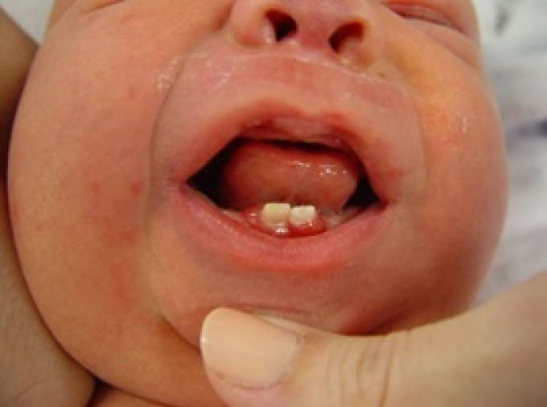
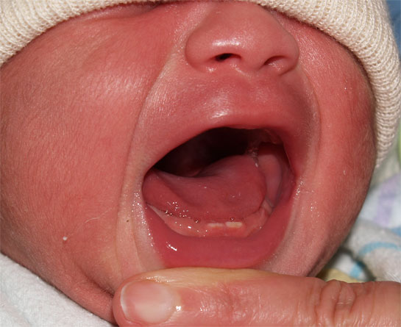
85% are the deciduous mandibular incisors

Slide 34
Natal > Neonatal teeth ( 3:1 )
Females > males
Riga Fede disease : Cause ulcerations on the ventral surface of tongue : difficulty in suckling & feeding : nutritional deficiency of infant

Slide 35
Features to be mentioned in Deciduous dentition period
Natal & Neonatal teeth
Spacing
Primate space
Sequence of eruption
Flush terminal plane
Deep bite

Slide 36
SPACING
Spacing in decicuous dentition
Physiological spaces / developmental spaces
Imp. for development of normal permanent dentition
Absence of space = crowding (as perm teeth are larger in size)

Slide 37
Physiological spaces / developmental spaces

Slide 38
Primate Space
Spacing seen is :
Mesial to maxillary canine & Distal to mandibular canine
Helps in placement of canine cusps of opposing arch

Slide 39
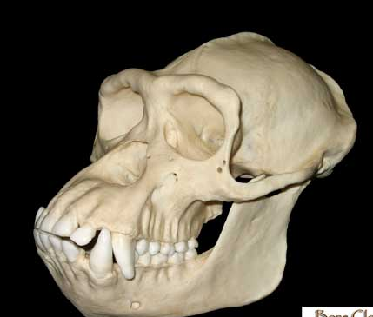
Also called :
Primate
Simian
Anthropoid spaces

Slide 40
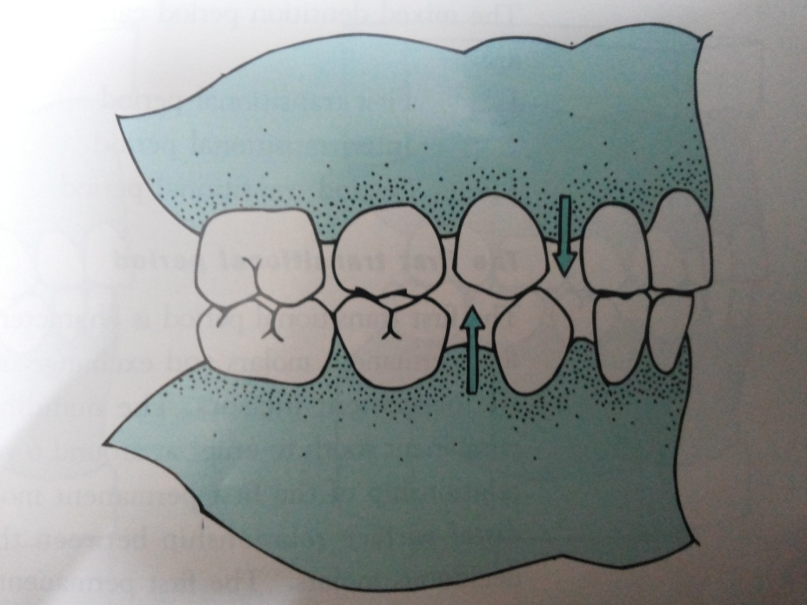
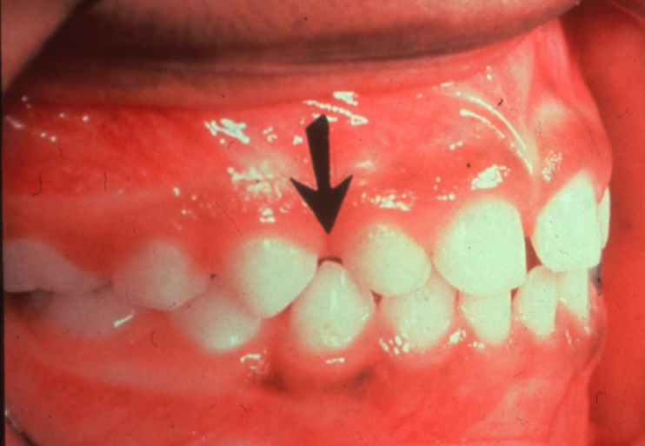

Slide 41
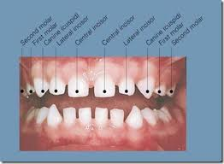
Sequence of eruption - Primary dentition
AB D C E
A B D CE

Slide 42
Flush Terminal Plane
Terminal plane = Mesio-distal relationship of distal surfaces of max & man 2nd deciduous molar.
Flush / end on relationship = where both the surfaces are in one vertical plane.

Slide 43
D
M
Primary (deciduous ) dentition has Flush terminal plane (end on relation)

Slide 44
Deep bite
Normal in deciduous teeth
? = deciduous incisors are more upright than their successors
Incisal edges of lower teeth contact cingulum of upper teeth

Slide 45
Deep bite = increase in vertical overlap of maxillary incisors over mandibular incisors

Slide 46
Deep bite is later reduced by :-
Eruption of deciduous molars
Attrition of incisors
Forward movement of mandible

Slide 47
MIXED DENTITION PERIOD
Starts at 6 years (eruption of 1st permanent molar )
Deciduous + permanent teeth (both are present)
Also called transitional dentition period
Classified into three:
1st transitional period
2nd transitional period
3rd transitional period

Slide 49
1st transitional period (6-7 yrs, eruption of 1st molars & incisors)
2nd transitional period (7-9 yrs, stable period)
3rd transitional period ( 10-12 yrs, eruption of canines & premolars)

Slide 50
1st Transitional period
Emergence of 1st permanent molars & exchange of deciduous incisors with permanent incisors.
1st mandibular molars (6yrs).

Slide 51
The relationship between distal surfaces of upper & lower molars can be of three types :
Flush/ end on
Terminal plane
Distal Step
Terminal plane
Mesial Step
Terminal plane

Slide 52
Flush/ end on
Terminal plane
Distal Step
Terminal plane
Mesial Step
Terminal plane
Angle’s Class I
Angle’s Class II
Angle’s Class III

Slide 53
For transition of flush relation to Class I occlusion lower molar has to move about 4-5mm forward.
This occurs by :
Utilization of physiologic spaces
Utilization of leeway space
Forward growth of mandible

Slide 54
Transition of flush relation to Class I occlusion

Slide 55
In Mesial step terminal plane :
The permanent molars erupt directly into Angle’s Class I occlusion or into Angle’s Class III relation

Slide 56
In Distal step terminal plane :
Erupting permanent molars are in Angle’s Class II relation

Slide 57
Exchange of Incisors
Permanent incisors are larger than deciduous incisors they replace.
The difference between amount of space needed (for accomodation for permanent incisors) & amount of space available = INCISAL LIABILITY

Slide 58
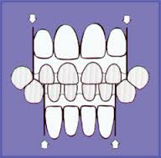

Slide 59
Incisal liability = 7mm (Maxillary arch)
= 5mm (Mandibular arch)
Incisal liability is overcome by:-
Utilization of physiologic spaces
Increase in intercanine width
Change in incisor inclination (primary incisors are more upright while permanent are labially inclined)

Slide 60
2nd (Inter ) transtional period
Till now the 1st molars & incisors are erupted.
The maxillary & mandibular arches consist of sets of deciduous & permanent teeth.
Relatively stable stage & no change occurs.

Slide 61
Third transition period
Characterized by eruption of canines & Premolars
which replace the deciduous canines & molars.

Slide 64
Leeway space
Combined MesioDistal width of permanent canines & premolars is usually less than that of deciduous canines & molars.
This surplus space is = Leeway Space of Nance

Slide 66
Leeway space is greater in mandibular arch than in maxillary arch
Mandibular arch = 3.4mm (1.7mm on each side)
Maxillary arch = 1.8mm (.9mm on each side)

Slide 67
Significance :
This leeway space is used for mesial drift of mandibular molars to establish Class I relation
Flush terminal plane
Angle’s class I

Slide 68
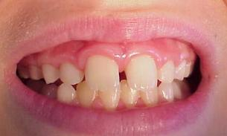
Ugly duckling stage
Described by Broadbent
Called as ugly duckling stage are children look ugly during this phase.
During eruption of maxillary permanent canines

Slide 69
Transient / self correcting malocclusion
Maxillary incisor region
Around 8-9 years

Slide 70
Eruption of maxillary permanent canines
Roots of lateral incisors are displaced mesially
Force is transmitted to central incisor roots and they are also displaced mesially
Result = crowns of central incisors diverge distally
Spacing between 2 central incisors

Slide 71
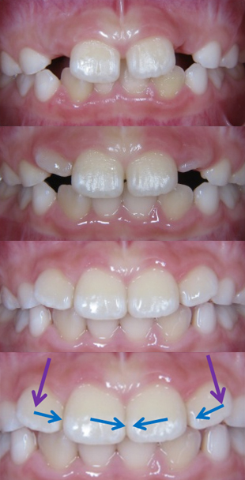

Slide 72
When canines erupt – pressure is transferred from roots to coronal area – situation corrects by itself.

Slide 73
Permanent dentition period
After 13-14 years
Eruption sequence
6 1 2 4 3 5 7
6 1 2 3 4 5 7

Slide 74
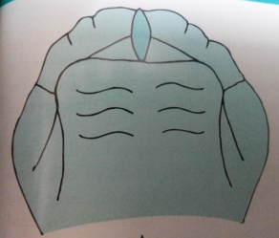
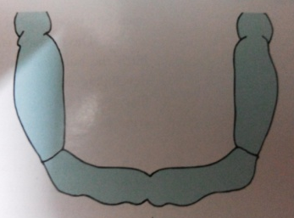
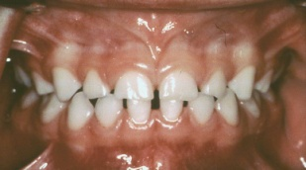
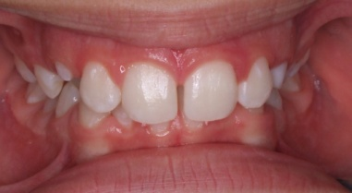
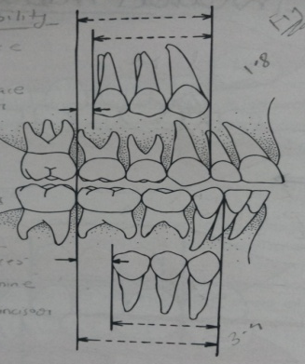
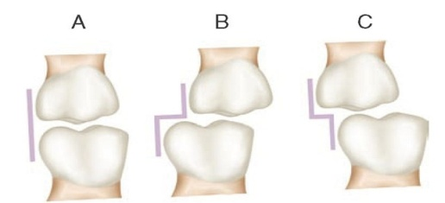
Pre dental period
Deciduous dentition period
Mixed dentition period
Permanent dentititon period
AB D C E
A B D CE
6 1 2 4 3 5 7
6 1 2 3 4 5 7

Slide 76
Occlusion terminologies & Curves
Balanced occlusion
Curve of Spee
Curve of Monson
Curve of Wilson
Andrew’s six key to Normal occlusion

Slide 77
Balanced occlusion :
An occlusion in which balanced and equal contacts are maintained throughout the entire arch during all excursions / movements of mandible

Slide 78
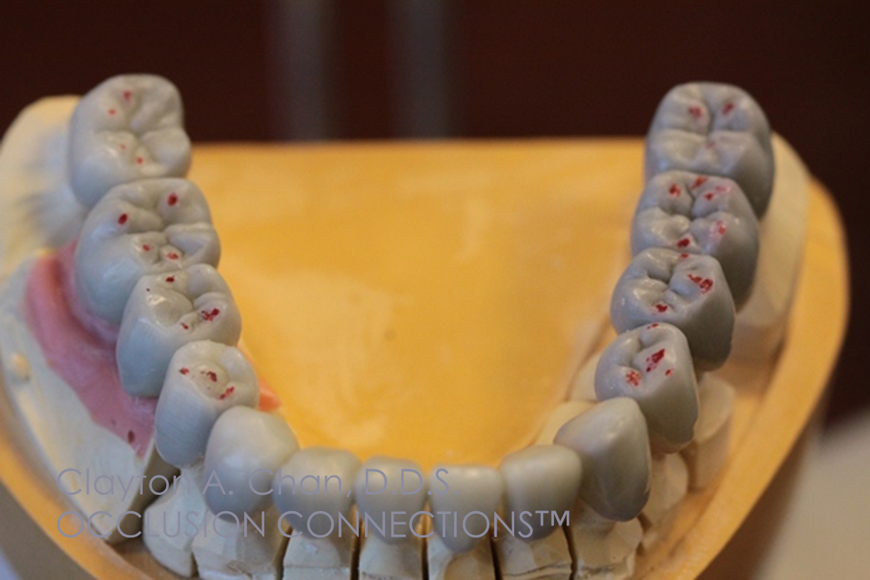
balanced and equal contacts

Slide 79
Types of Cusps
1) Centric holding cusps
2) Guiding cusps

Slide 80
1) Centric holding cusps
Also called as stamp cusp (or) supporting cusp
The lingual cusps of maxillary posterior teeth & buccal cusps of mandibular posterior teeth
They occlude into the central fossa & marginal ridges of opposing teeth

Slide 82
2) Guiding cusp
Also called as shear cusp (or) non-supporting cusp
The buccal cusps of maxillary posterior teeth & lingual cusps of mandibular posterior teeth
They function to guide the mandible during lateral excursions & shear during mastication

Slide 84
2 types of cuspal relations
Cusp-Fossa occlusion
Cusp-Embrassure occlusion

Slide 85
Cusp Fossa occlusion
The supporting cusp of one tooth occludes in a single fossa of single opposing tooth
This is a tooth – to – tooth arrangement

Slide 87
Cusp Embrassure occlusion
When a tooth occludes with two opposing teeth
( Cusp of one tooth occludes with the embrassure of two opposing teeth)
Tooth – to – two teeth occlusion

Slide 89
Imaginary curves of occlusion (or) Compensatory curves of occlusion
1) Curve of Spee (or)
Anteroposterior curve (or)
The curve of occlusal plane
The anterio-posterior curvature of the occlusal surfaces continuing as an arc throughout the condyle

Slide 90
The curve begins at the tip of lower cuspid, following the cusp tips of bicuspids & molars
Continues as an arc through condyle
A circle of 4 inches diameter is formed
Depth of curve = 1.5 – 2.5mm

Slide 91
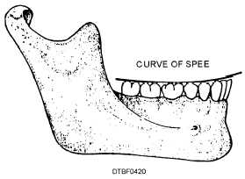
A curved alingment is seen when observed from a point opposite to 1st molar
4’’

Slide 92
Curve of Wilson ( side–to–side curve )
A curve that contacts the buccal & lingual cusp tips of mandibular buccal teeth
Mediolateral on each side of arch
Due to inward inclination of posterior teeth

Slide 94
When viewed from anterior aspect with mouth slightly open :
The curve of maxillary arch is convex
The curve of mandibular arch is concave

Slide 95
Significance
Elevated buccal cusp prevents food from going past the occlusal table.
Teeth alingned parallel to medial pterygoid so less resistance to masticatory forces

Slide 96
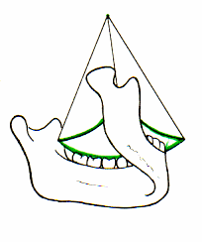
Curve of Monson
Got by extending curve of Spee & Wilson to all cusps and incisal edges

Slide 97
Andrew’s Six key to normal occlusion
Presence of these features are must to achieve ideal occlusion (Angle’s Class I)
Molar inter-arch relationship
Mesio distal crown inclination
Labio lingual crown inclination
Absence of rotation
Tight contacts
Curve of spee

Slide 98
Molar inter-arch relationship

Slide 99
Mesio distal crown inclination
The gingival part of long axis must be distal to occlusal part of crown
gingival part
occlusal part

Slide 100
Labio lingual crown inclination
Mesial or distal view
If gingival area of crown is more lingual than occlusal area = +ve crown inclination
If gingival area of crown is more buccal than occlusal area = -ve crown inclination

Slide 101
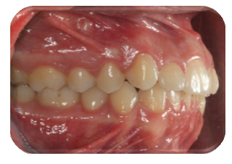
+ve crown inclination = maxillary incisors
-ve crown inclination = max & mand posteriors & mandibular incisors
-ve crown inclination
+ve crown inclination

Slide 102
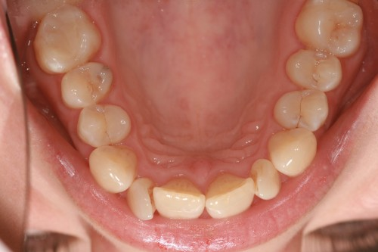
Absence of rotation
Normal occlusion is absent of any rotation

Slide 103
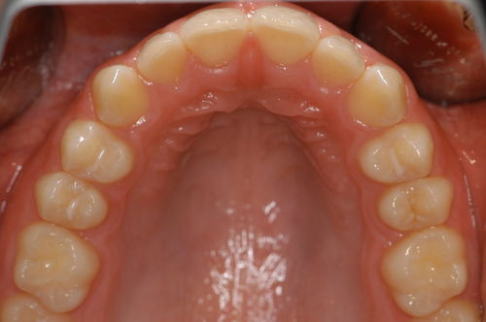
Tight contacts
Normal occlusion shows presence of tight contacts between adjacent teeth

Slide 104
Curve of Spee
Occlusal plane should be flat with curve of spee not exceeding 1.5mm

Slide 105
Summary/Take home message
Occlusion is the way in which the maxillary and mandibular teeth come together. This definition conjures up a static relationship; however, in function the teeth move across one another and this articulation or dynamic occlusion is equally important.

Slide 106
References
Davies, S; Gray, R M J (2001-09-08). "Occlusion: What is occlusion?". British Dental Journal. 191 (5): 235–245. doi:10.1038/sj.bdj.4801151. ISSN 0007-0610. S2CID 1527778
Salzmann, J.A. (June 1965). "The Angle classification as a parameter of malocclusion". American Journal of Orthodontics. 51 (6): 465–466. doi:10.1016/0002-9416(65)90243-5. ISSN 0002-9416. PMID 14287832.
Nelson, Stanley J. (2014-11-25). Wheeler's dental anatomy, physiology, and occlusion. ISBN 9780323263238.

Slide 107
Frequently Asked Questions
Define & Classify Occlusion. Mention different stages/periods of development of occlusion.
Infantile Open Bite
Natal & Neonatal teeth
Sequence of eruption
Flush Terminal Plane
Leeway space of Nance
Ugly duckling stage (Broadbent space)
7. Balanced occlusion
8. Imaginary curves of occlusion:
Curve of Spee
Curve of Monson
Curve of Wilson
9. Andrew’s six key to Normal occlusion

Slide 108
THANKYOU

